Slide 1

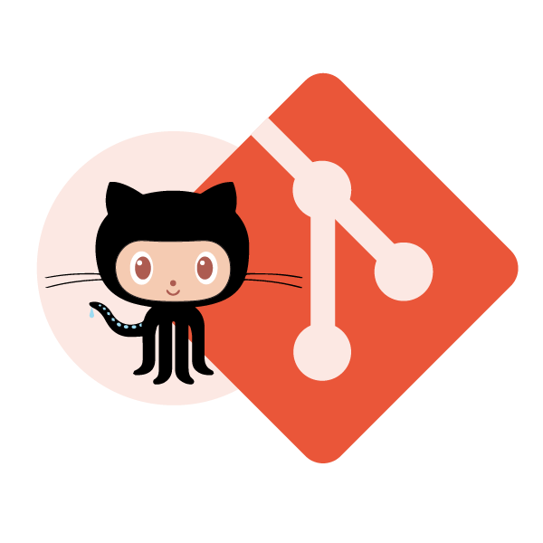
Know the Science behind Workflows using
Git & GitHub
Presenter Name : Prithviraj Bose

Slide 2

Know your instructor
18 years of experience in Software Development
Previously worked at Cisco, NDS Service Pay TV technology & Wisor Telecom
One of the implementers of TataSky, Airtel and many other digital broadcast solutions
Currently engaged in consulting and training in the areas of
TDD/ATTD, Emerging Design & Refactoring
REST API Design
Elasticsearch
Programming Languages: Java, C++, Python.
Software Design: Using patterns, SOLID principles
Prithviraj Bose
IIM - Bangalore

Slide 3





Today’s Topics
Why Version Control Systems
Traditional Version Control Systems
Why Git?
What is GitHub?
Git Shell & GitHub UI Demo
Hands-On with Git & GitHub

Slide 4
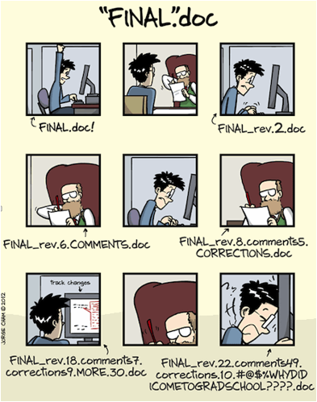
We all have done it – Isn’t It

Slide 5
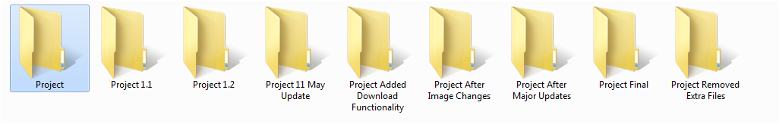
We all have done it – Isn’t It

Slide 6
We all have done it – Isn’t It
Because we were not told about Version Control System

Slide 7
Version Control System

Slide 8
Version Control System
Version control systems are softwares that manage changes to files e.g. documents, images, code, basically everything

Slide 9
What you get from a Version Control system
Some of the major benefits of using a Version Control System are listed below :
Saves you from creating multiple backups of your files
Allows multiple people to work on same file
Tracks changes and also who have made those changes
Easy to switch back to older versions as and when required
Makes you more productive

Slide 10
Traditional Tools for Version Control
Open Source
CVS
SVN
Proprietary
IBM Rational ClearCase
Perforce
Client-Server Model
Client-Server Model
Client-Server Model
Client-Server Model

Slide 11
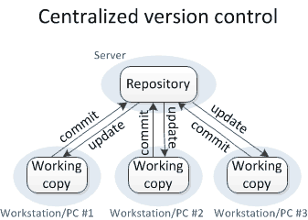
Problem with Client Server Model
Client-Server version control systems work on a centralized model which has a single repository to which users check-in and check-out
Some of the major benefits of using a Version Control System are listed below :
Version Control is not available on local systems
If the central server gets corrupted the entire history is lost

Slide 12
What’s the Solution ?

Slide 13
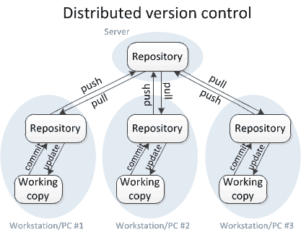
Distributed Version Control
Distributed Version Control Systems (DVCS) don’t rely on a central server. It allows one to clone the repository on their own hard drive with entire history of the project
Benefits of using a Distributed Version Control System are listed below :
With DVCS version control is also available on local systems
No single point of failure as each user have the repository with entire history
Allows you to perform all actions locally, even when not connected to Internet

Slide 14
Welcome to Git

Slide 15
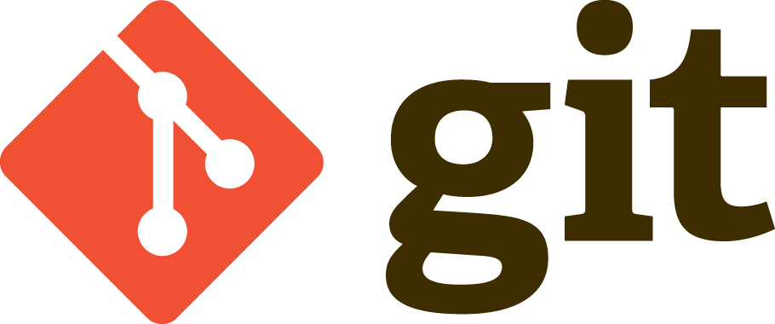
Git
Initially developed by Linus Torvalds, Git is a distributed version control system
Design Philosophy
Free and Open source
Blazingly Fast
Distributed
Data Assurance

Slide 16
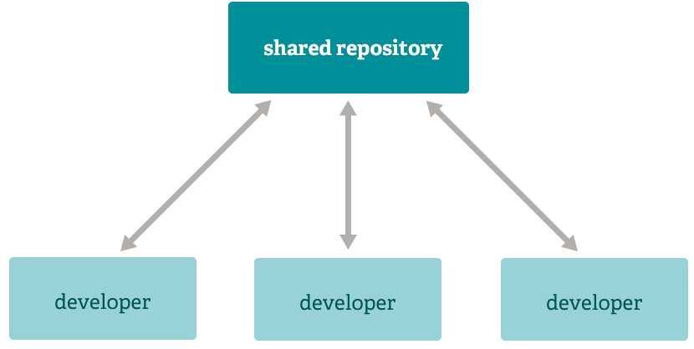
Classic Client-Server Workflow

Slide 17
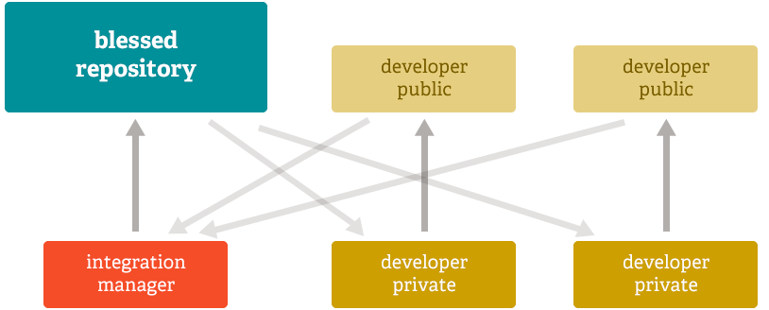
Git’s Flexible Workflows
Typical Open Source

Slide 18
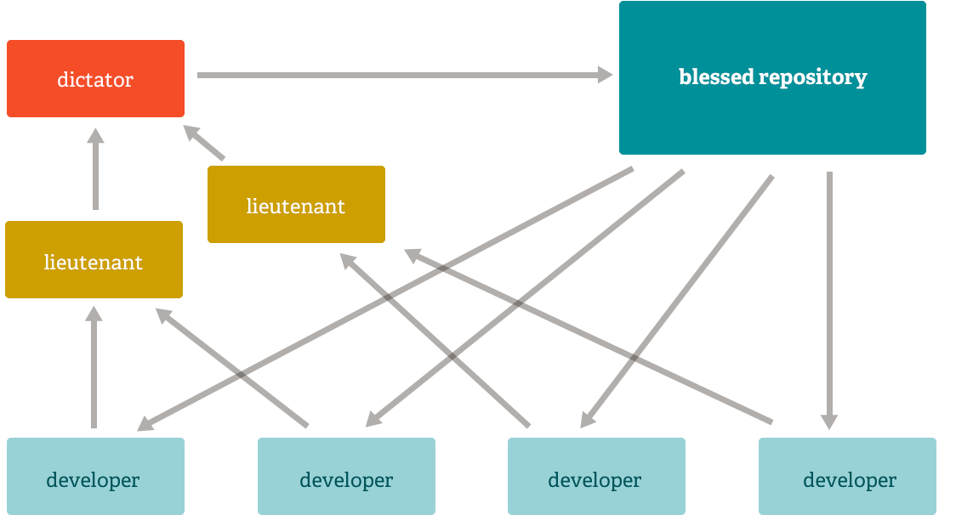
LINUX Style Workflows
LINUX Style

Slide 19
Git Repository Structure
A local repository consists of three partitions maintained by Git.
The first one is the WORKING DIRECTORY which holds the actual files.
The second one is the INDEX which acts as a STAGING AREA
Finally the third one is the HEAD which points to the last commit made.

Slide 20
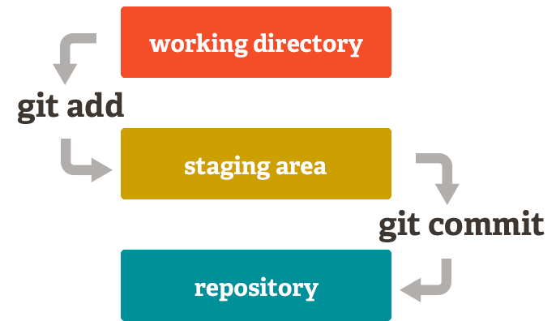
Git Repository Structure
<- Why do I need this?
<- Local Repository

Slide 21
What is GitHub?
GitHub is a web-based Git repository hosting service with more than 28 million repos
Provides features like Code Comparison, Code Sync and Git shell

Slide 22
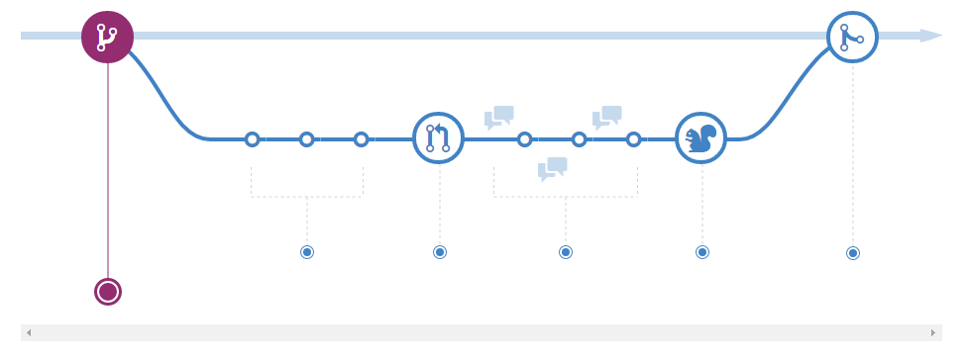
A Typical Day with Git & GitHub
> Branch
> Commit
> Review
> Deploy
> Merge
> Submit Pull Request

Slide 23
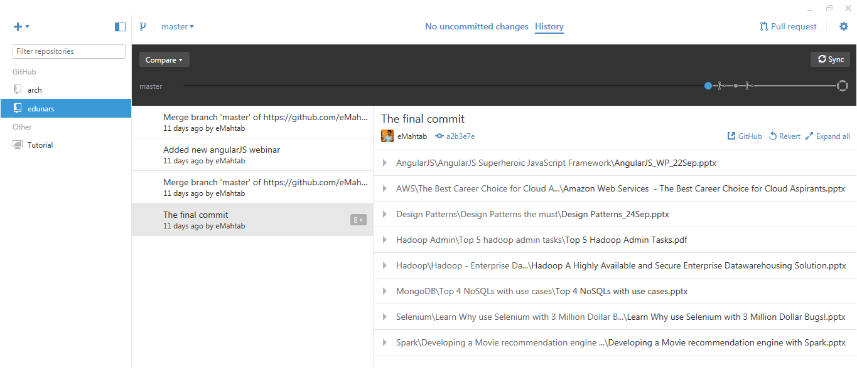
Demo: GitHub GUI & Shell

Slide 24
Sample Commands
# sync-ing the local from remote Github repo
> git pull https://github.com/prithvirajbose/jws.git
# adding to staging area
> git init
> git add *
> git commit -m “v1.0"
# push to remote Github repo
> git push -u origin master

Slide 25
Course Details

Slide 26

Course Details
Get Certified in Git and GitHub by Edureka
Go to www.edureka.co/git-github
Batch starts from 17 October (Weekend Batch)
Edureka's Git & GitHub course:
Become a Git & GitHub expert by mastering concepts like Branches, Design and Git work flow by using Git Command Line, GitHub Desktop and SourceTree.
Online Live Courses: 24 hours
Assignments: 25 hours
Project: 20 hours
Lifetime Access + 24 X 7 Support

Slide 27
Thank You
Questions/Queries/Feedback
Recording and presentation will be made available to you within 24 hours

